Slide 1



Introduction to App Development with .NET MAUI
Microsoft Confidential
Clifford Agius
Cliffordagius@CA-Software.co.uk
@CliffordAgius
@CliffordAgius@hachyderm.io

Slide 2
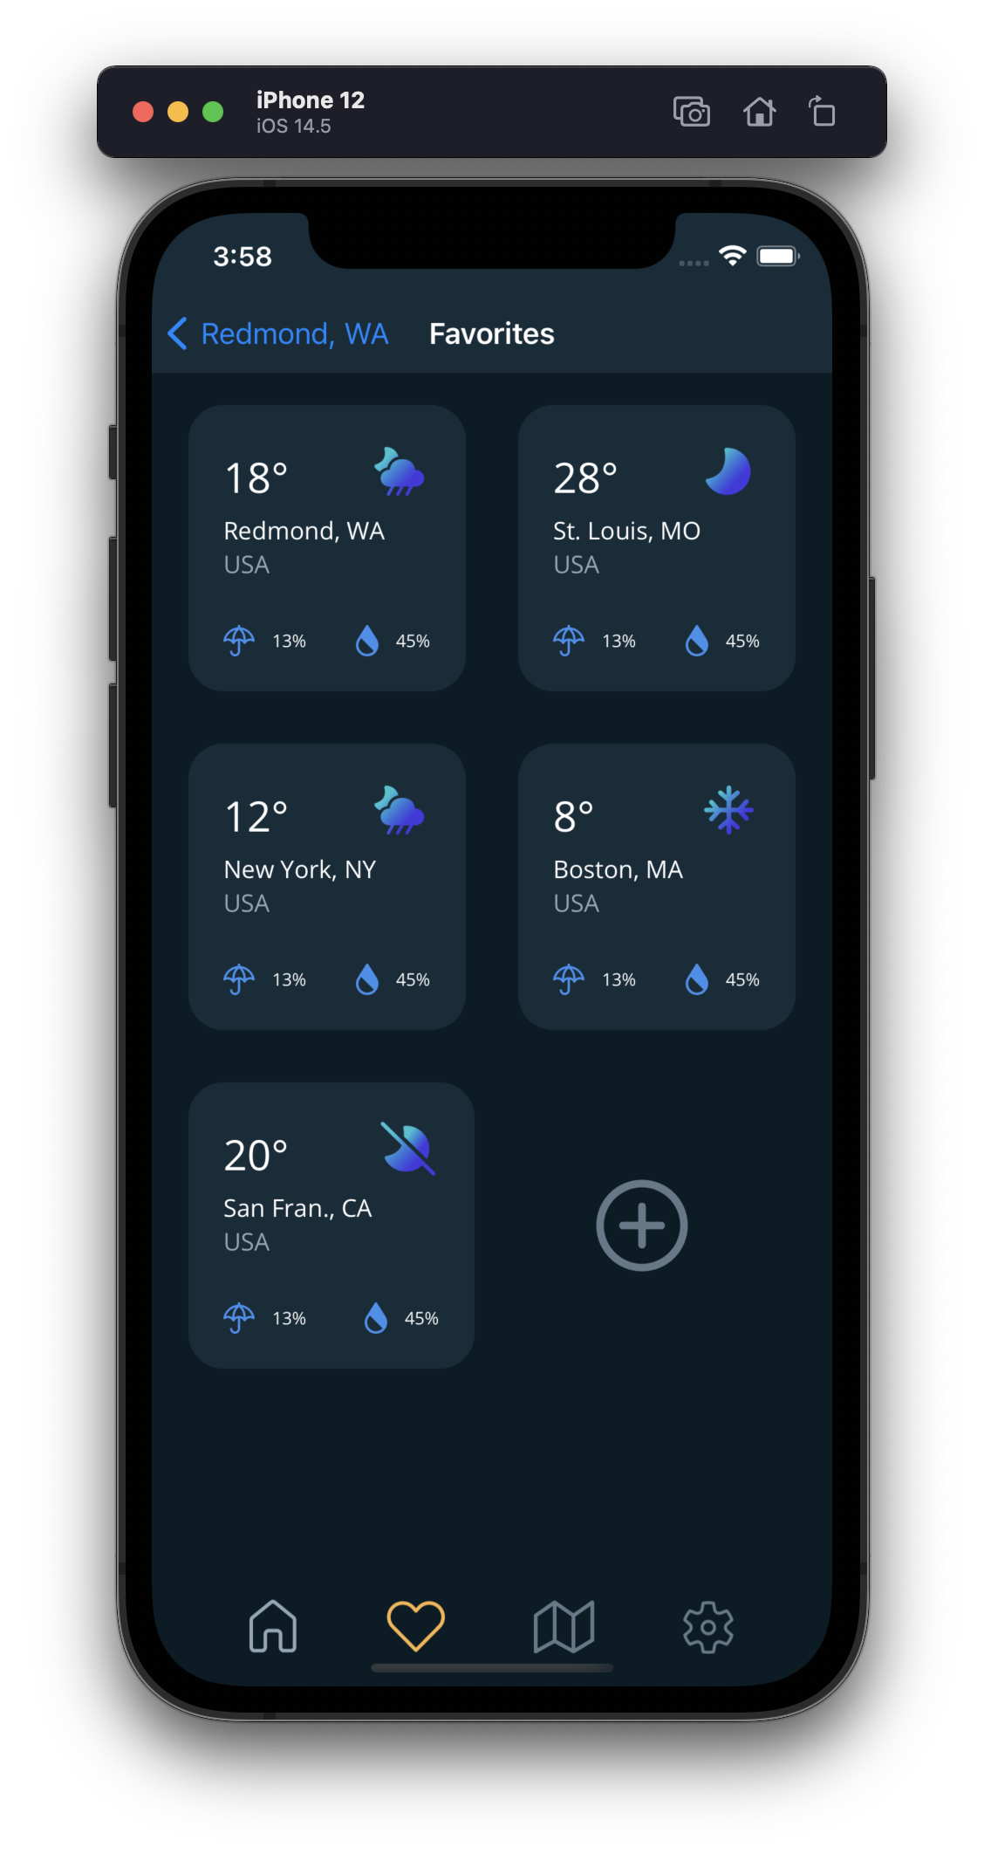
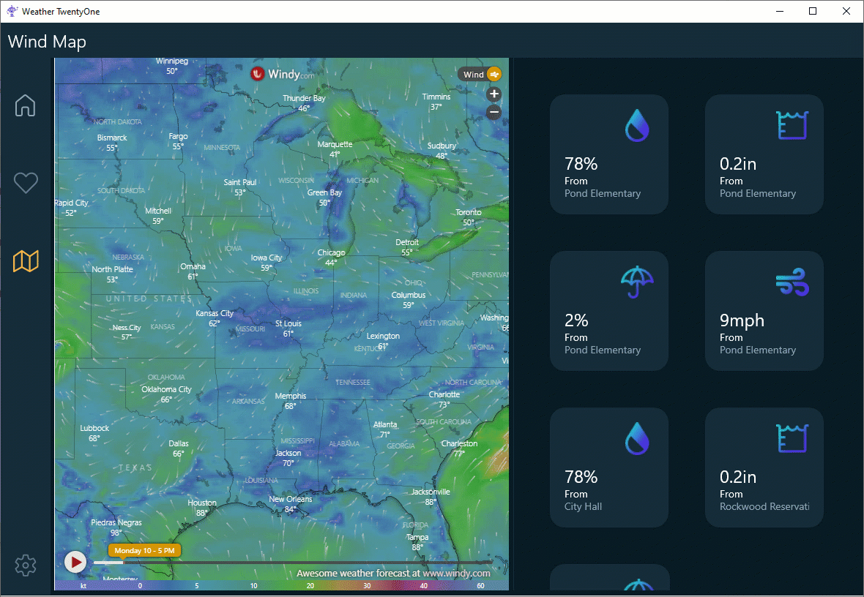
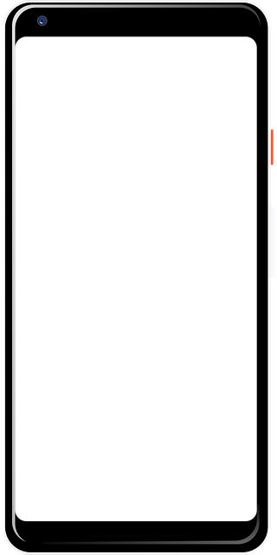
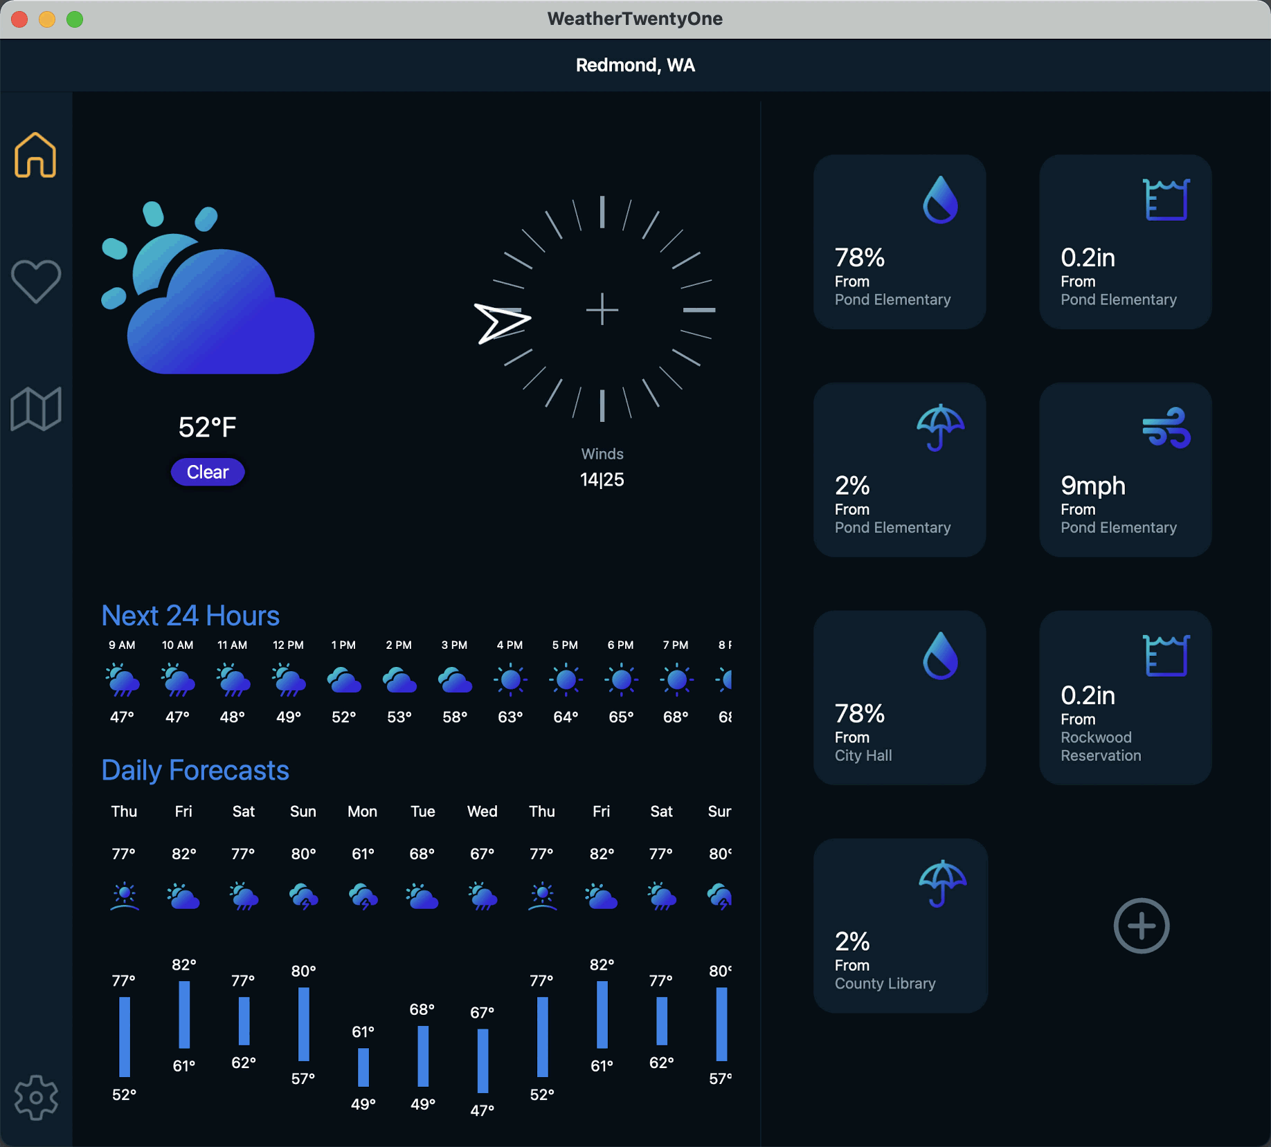
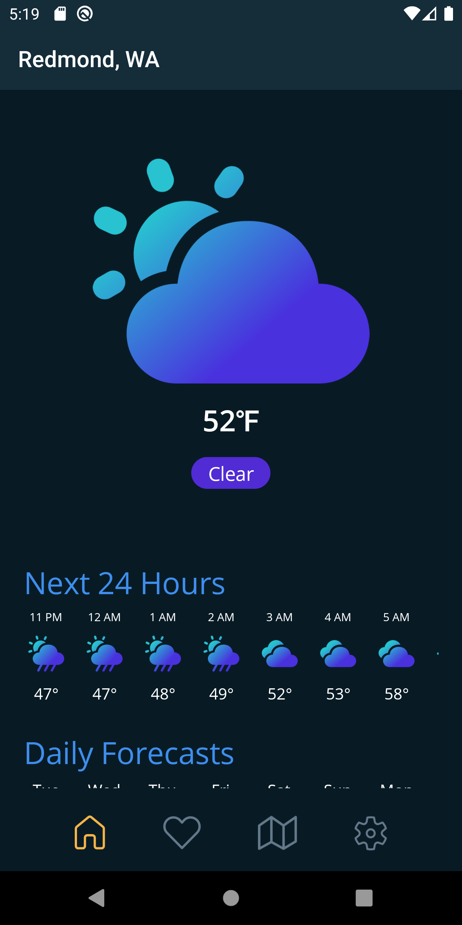
Agenda
.NET MAUI Overview
Project system improvements
Faster development with Visual Studio 2022
.NET MAUI Deep Dive

Slide 3
.NET MAUI is the most productive way to develop native apps that perform great on any device that runs Android, iOS, macOS, Windows and Tizen from a single codebase.

Slide 4
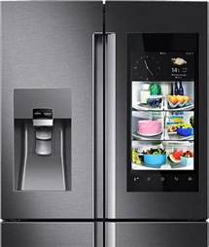




How does .NET MAUI work?
.NET Multi-platform App UI
.NET for Android
.NET for iOS / Mac Catalyst
WinUI
.NET for Tizen
.NET Base Class Library (BCL)
App Code
.NET Runtime
Android
iOS
macOS
Windows
Tizen
iOS
macOS
Notes:
How is it native?
Everything starts with your app code. This is where you want to spend all your time being productive. And you want to deliver your app on 1+ devices
The first layer of the technology cake is the native platform SDK. This what Google, Android, and Microsoft ship for those platforms
So how do we get from our .NET app code to those platforms and running on devices?
First we need something that can run .NET code: the .NET Runtime. (Yes, it uses MonoVM on mobile and Mac, and CoreCLR on Windows, but that’s not terribly important because...)
Next we need a common .NET API we can write our code against, and that’s the Base Class Library (BCL). New in .NET 6 app runtimes use the same BCL.
To use .NET against native platform SDKs we need a .NET representation of them. We do this via binding a .NET API and implementation to the native API. When you call a native method from C#, it’s just as if you had done it from Obj-C, Swift, Java, Kotlin, or C++.
The final layer of the cake that really makes it delicious is .NET MAUI. .NET MAUI provides a rich library of controls, layouts, and services that work across all of the platforms supported, so you need only master one API to get native apps.
(next slide) With .NET MAUI, all of that complexity is delivered in a single framework that gives you access to it all.

Slide 5
How does .NET MAUI work?
App Code
.NET Multi-platform App UI
iOS
macOS
Notes:
With .NET MAUI, all of that complexity is delivered in a single framework that gives you access to it all.

Slide 6
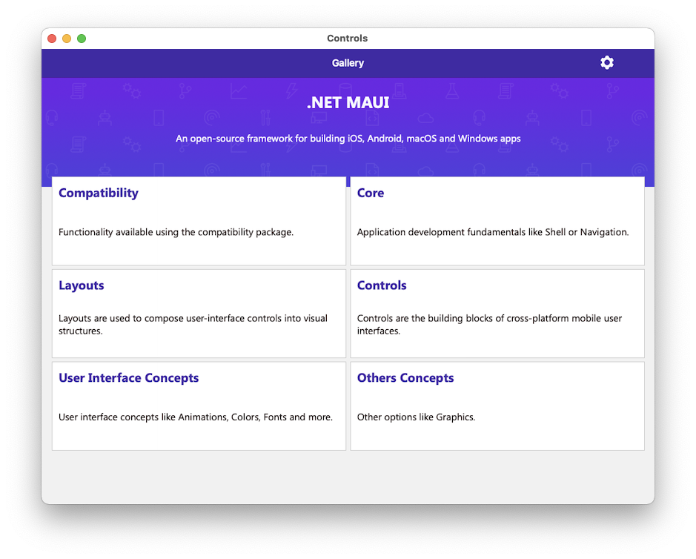
Rich Library of Controls
40+ Controls
Navigation
Flyout Menu
Bottom Tabs
Top Tabs
Hierarchical
Adaptive layouts
Right-to-Left
Semantic Accessibility

Slide 7
Controls
CarouselView
CollectionView
RefreshView
IndicatorView
Checkbox
RadioButton
ImageButton
SwipeView
ActivityIndicator
BoxView
Button
DatePicker
Editor
Entry
Image
Label
ListView
Map
OpenGLView
Picker
ProgressBar
SearchBar
Slider
Stepper
TableView
TimePicker
WebView
EntryCell
ImageCell
SwitchCell
TextCell
ViewCell
Path
Ellipse
Polygon
Rectangle
Line
Polyline
Notes:
You have more than 40 controls, layouts, and pages to mix and match from.
These are all of the controls you have out of the box, you can of course create your own.
What is unique is you get the native control and have access to it.

Slide 8






Component Vendors
Notes:
And, our partners building controls make much of this possible, creating gorgeous pre-built UI controls for you to drop right in to your app

Slide 9
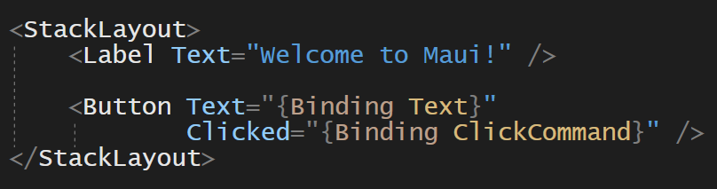
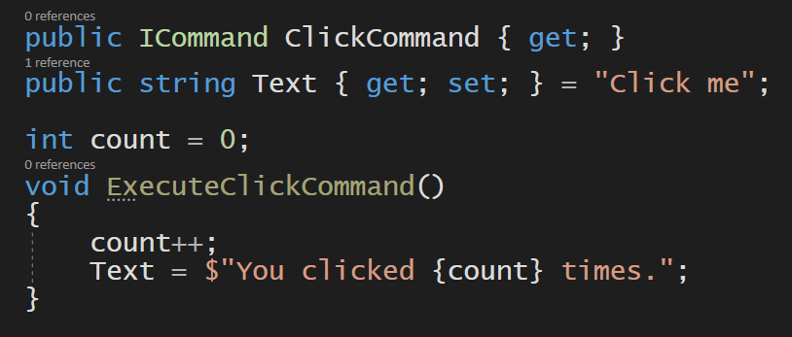
Building UI in .NET MAUI
Optimized for XAML, C#, and MVVM

Slide 10
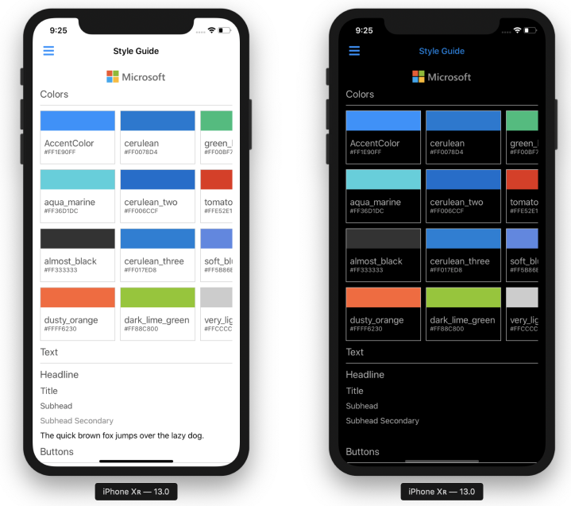
Abundant Styling Options
Themes for dark and light
Static and dynamic styles
XAML and CSS
Visual State Manager
Custom fonts and font icons
Images from many formats including SVG

Slide 11
Easily customize controls
#if ANDROID
Handlers.EntryHandler
.EntryMapper[nameof(IEntry.BackgroundColor)] = (h, v) =>
{
(h.NativeView as global::Android.Views.Entry).UnderlineVisible = false
};
#endif
#ifdef if platform specific
Access the handler from anywhere
Dictionary of all props
Notes:
The new handler architecture makes it easy to hook into any property and add/modify behavior right in .NET MAUI
In this example we hook into the background color and change the Android underline visibility on the Entry.
We could also, with a little more effort, add a custom property mapping specific to the underline and implement that with almost identical code.

Slide 12
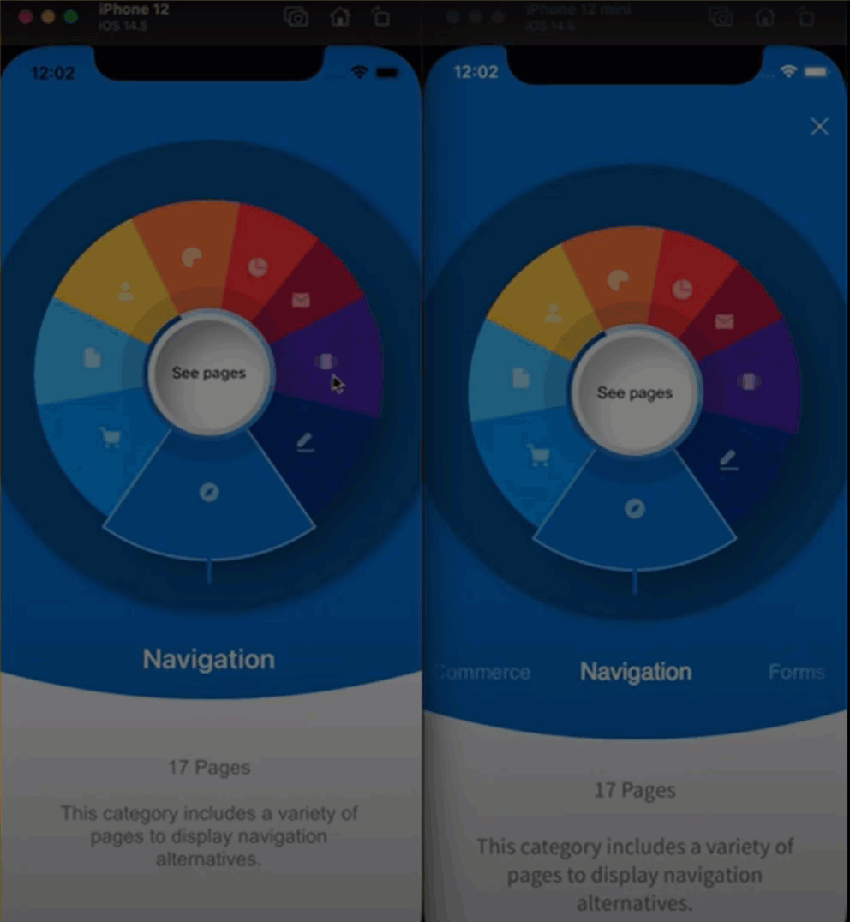
Pixel Perfect UI with Maui.Graphics
Xamarin.Forms with Skia Sharp
MAUI.Graphics
Native graphics or SkiaSharp
Fluent and Material design
Canvas with primitive drawing types
Attributed text
Bitmaps
PDFs
Unified Color types
Diego Grailkit UI - https://www.youtube.com/watch?v=rrgmCcf5vl8&t=1s

Slide 13
Project System Improvements
Optimized for Cross-Platform Workflows

Slide 14
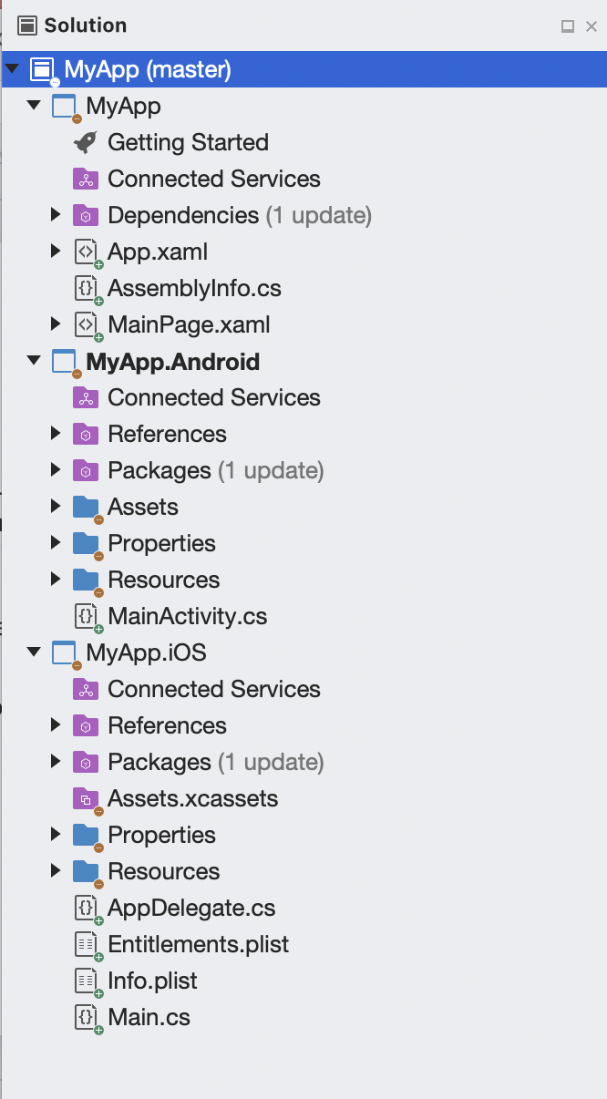
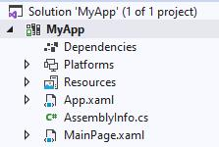
Single Project
Productivity
In Xamarin each target had a Project, this means you need to create and set-up multiple:
Project References and NuGets
Images
Fonts
App Icons
Splash screen
Notes:
One project can now publish to any of the platforms supported.
Images are optimized at build time for the multiple densities of screens required across all the platforms you target.
Fonts are registered in one location for every platform, and you can alias the name as you desire.
Platform code can all live within this one, multi-targeted project.
Splash screen support makes it easy to declare a visual asset (PNG or SVG for example) and a background color.

Slide 15
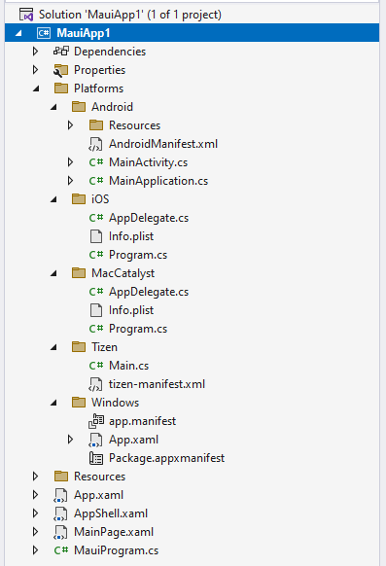
Single Project
Productivity
Reducing multiple projects to a single project alleviates several points of friction when developing apps that target multiple platforms.
Images
Fonts
Platform code
Styles
App Icons
Splash screen

Slide 16
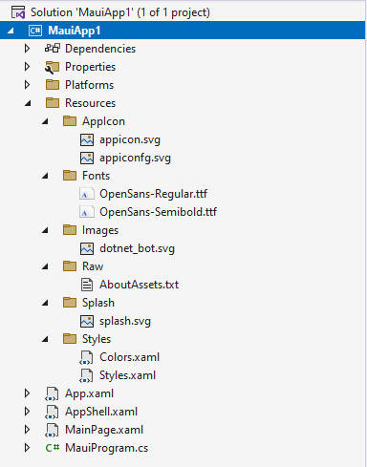
Single Project
Productivity
Reducing multiple projects to a single project alleviates several points of friction when developing apps that target multiple platforms.
Images
Fonts
Platform code
Styles
App Icons
Splash screen

Slide 17
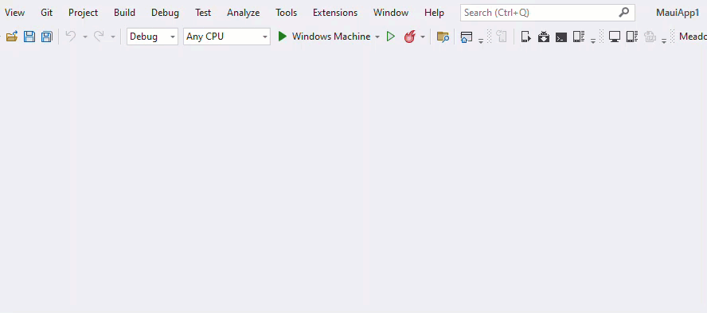
Single Project
Productivity

Slide 18
Faster Development
Optimized Inner-loop

Slide 19
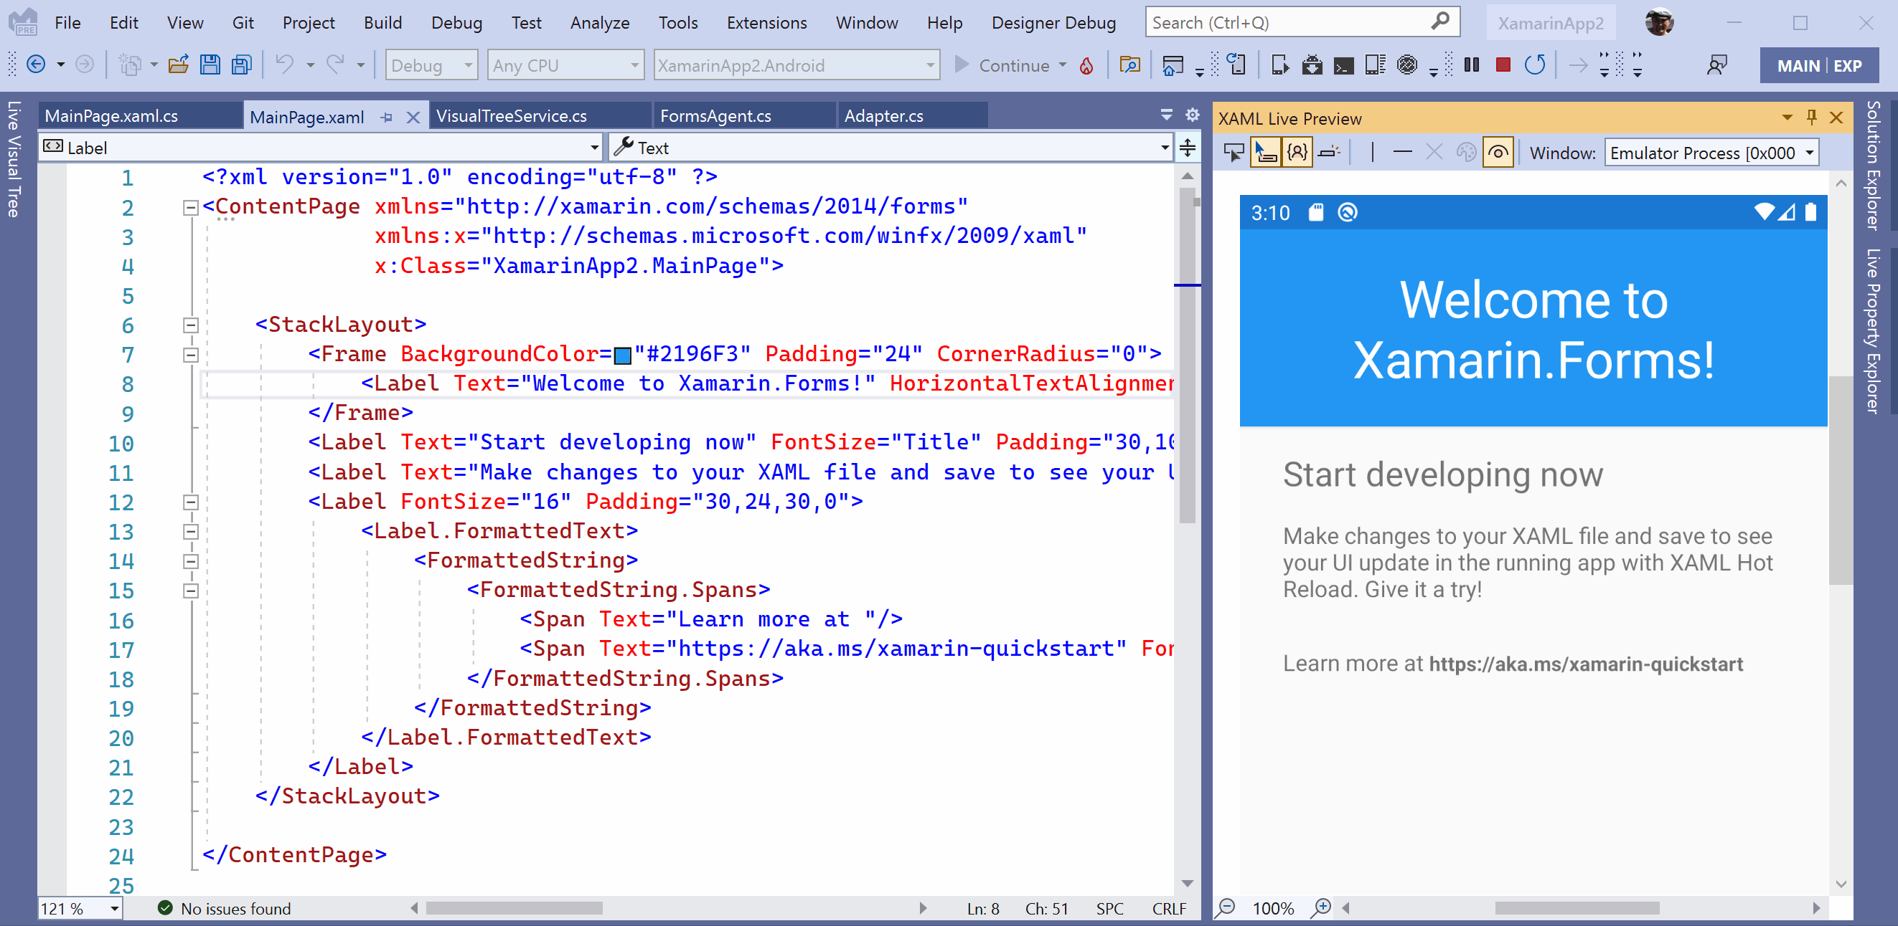
Code it Live
Productivity
Whether XAML or C#, you can code while debugging your application and see the changes instantly. No more stop-edit-rebuild for simple tweaks.
When you do something more complex, Visual Studio will prompt you to rebuild.
C#
CSS
Razor
XAML
Notes:
Code live whether it’s C#, CSS, Razor, or XAML. Less time building and more time coding.
In a future Visual Studio 2022 release you’ll also be able to see your app right inside the IDE where you can inspect elements and set UI guides.
(this is showing Xamarin.Forms and will be replaced with a .NET MAUI example. Same technology)

Slide 20
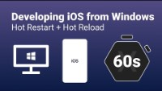
Windows and iOS
Productivity
Connect any iOS device directly to Windows and start coding in Visual Studio 2022. That’s it!
Changes are pushed from Visual Studio directly to the app running on device, no Mac build host required.
When you’re ready to publish and distribute, connect a Mac or use a cloud service to finish the job.
Notes:
Aka “Hot Restart” enables you to use your Apple developer account, a Windows dev machine, and any iOS device to build and test iOS apps.

Slide 21
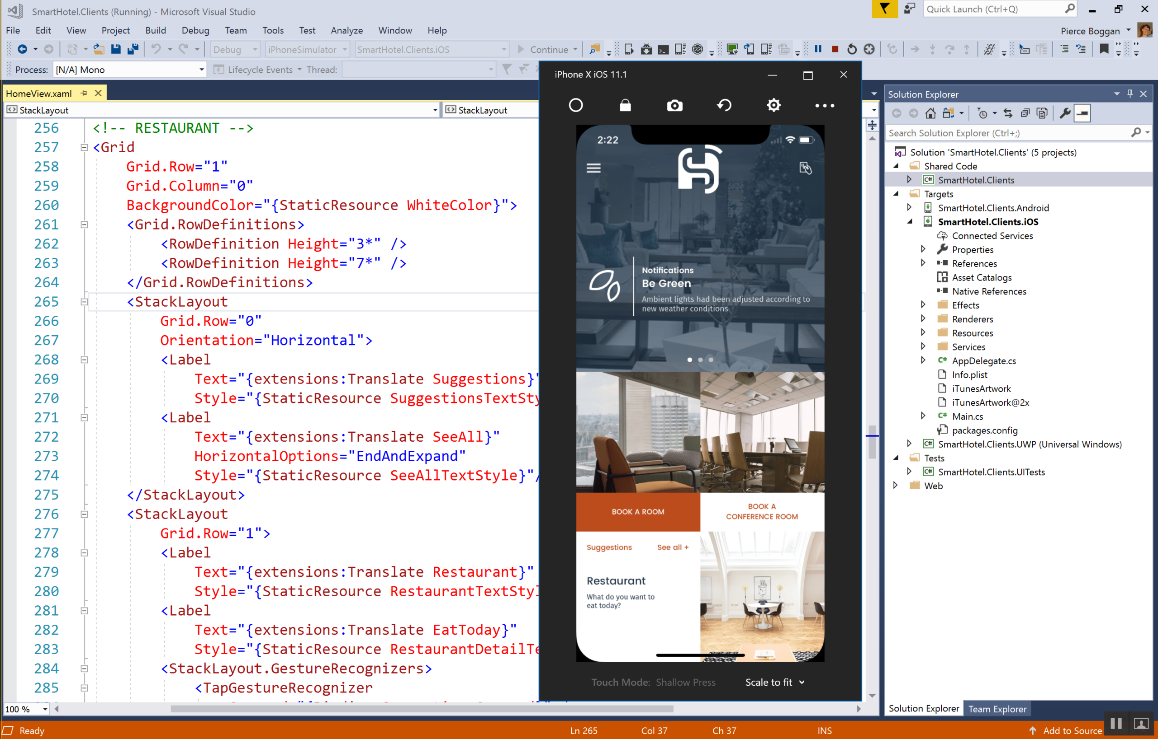
Remote iOS Simulator
Productivity
For more Apple features, connect your Visual Studio 2022 on Windows to a Mac on your local network. With this you get:
Native Xcode builds over SSH
Remote simulator
Touchscreen support
Notes:
Code live whether it’s C#, CSS, Razor, or XAML. Less time building and more time coding.
In a future Visual Studio 2022 release you’ll also be able to see your app right inside the IDE where you can inspect elements and set UI guides.
(this is showing Xamarin.Forms and will be replaced with a .NET MAUI example. Same technology)

Slide 22
And beyond
More ways to use .NET MAUI

Slide 23
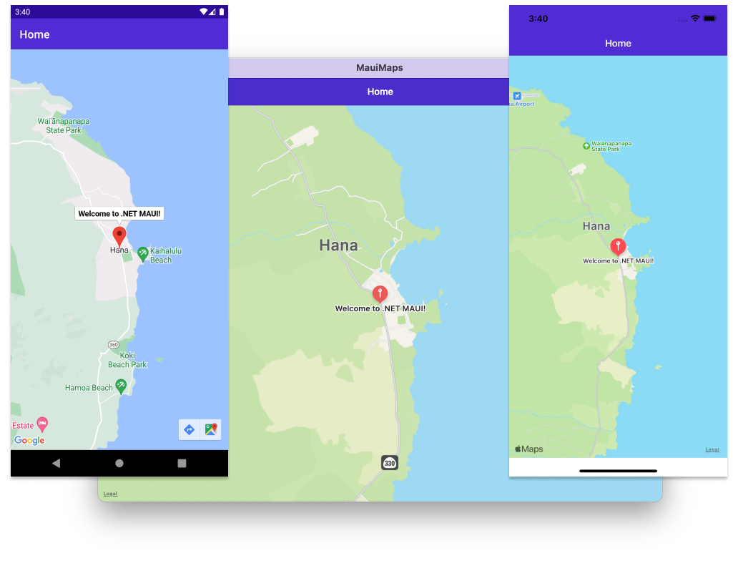
.NET MAUI in .NET 7 – 7.0.59 Service Release 3
Bonus

Slide 24
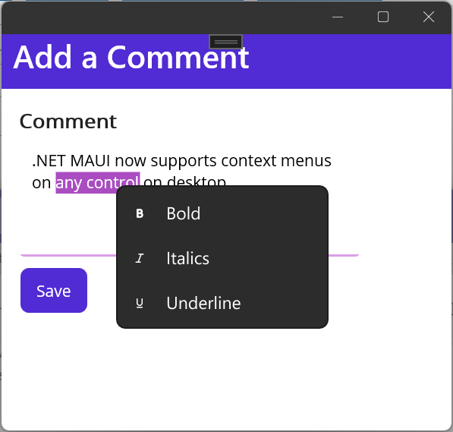
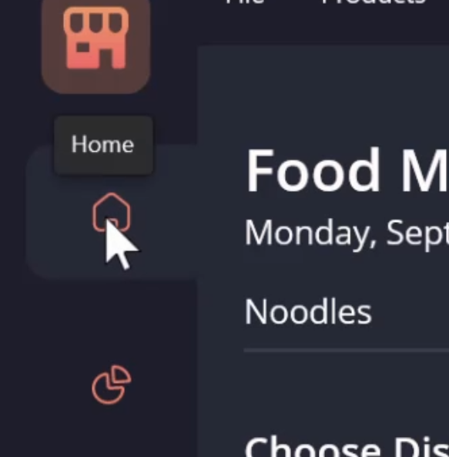
.NET MAUI in .NET 7 – 7.0.59 Service Release 3
Bonus
Context Menu’s
Tooltips
Gestures
Window size/position

Slide 25
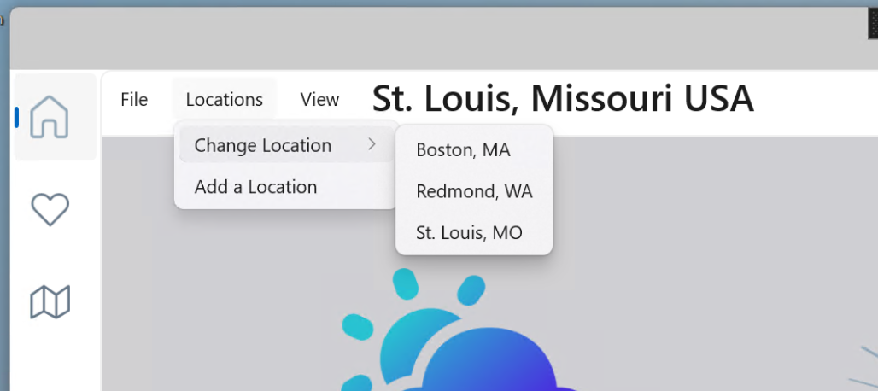
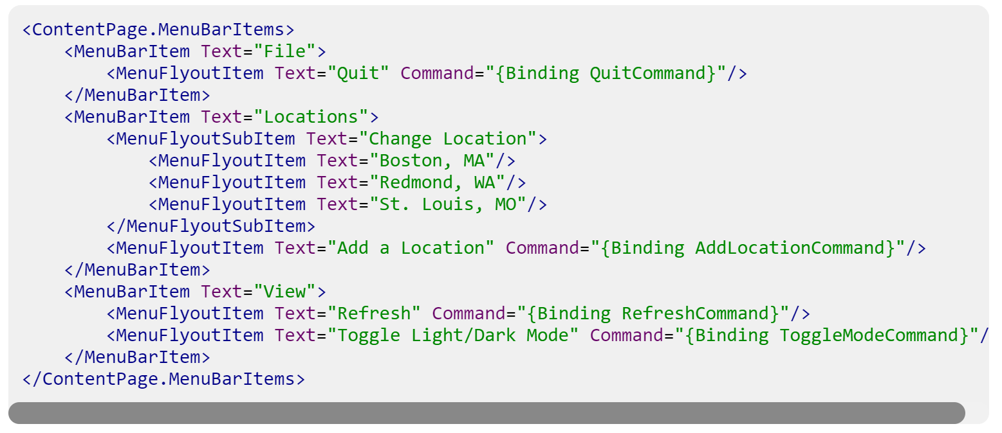
Desktop Menu Bar
Bonus

Slide 26
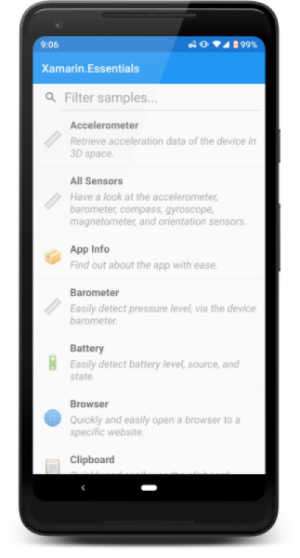
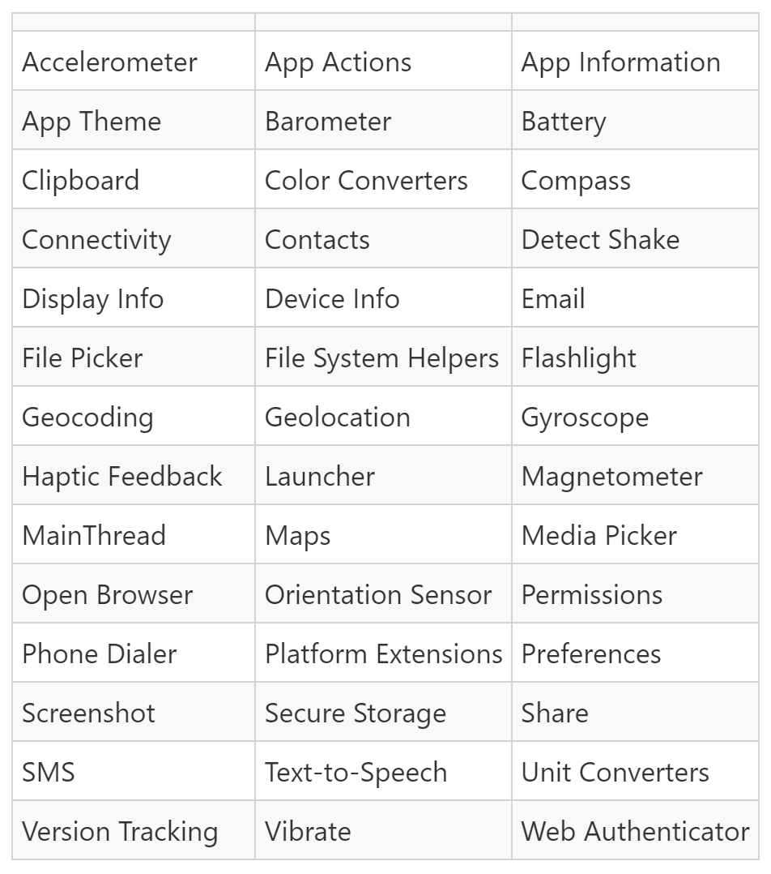
Essentials
Bonus
Devices
To access device services across all .NET MAUI targets.
Now with Interfaces so you can Mock items like your GeoLocation.

Slide 27
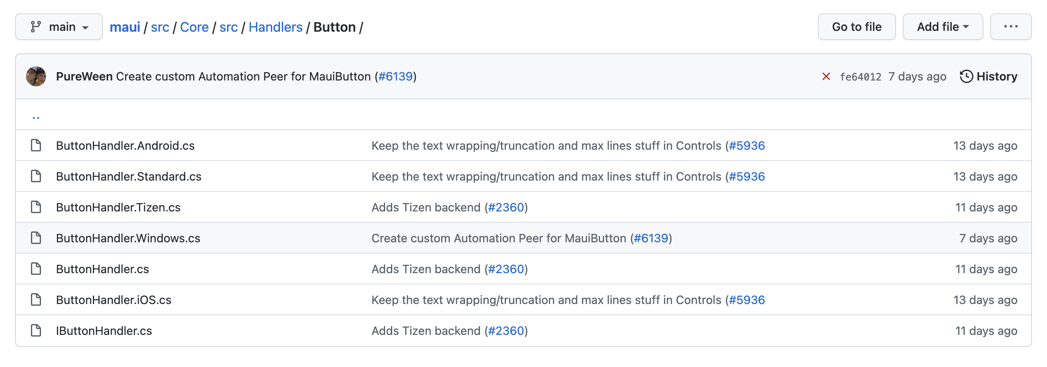
File Name Convention
Bonus

Slide 28
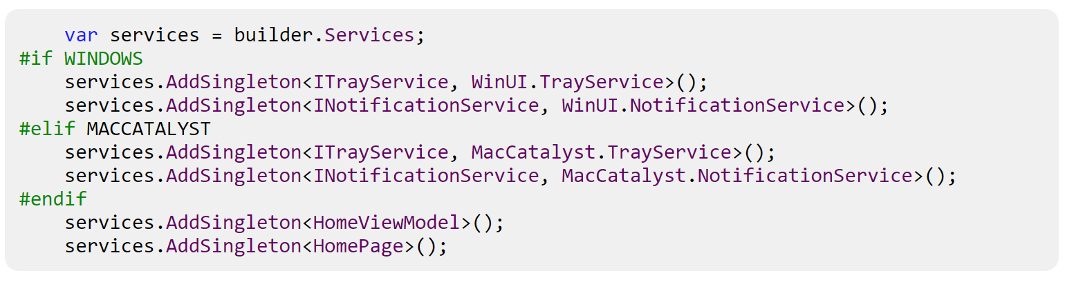
Multi-Targeting
Bonus
Multi-targeting also works via conditional compilation arguments. By using #if, you can segment code per platform from anywhere in your project.
For example, in the WeatherTwentyOne app’s MauiProgram.cs, we configure services for local notifications and the system tray, which are very platform-specific APIs.

Slide 29
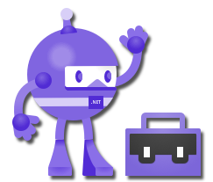
Bonus
.NET MAUI Community Toolkit -
Behaviors
EventToCommandBehaivor
ImpliedOrderGridBehavior
MaskedBehavior
MaxLengthReachedBehavior
ProgressBarAnimationBehavior
UserStoppedTypingBehavior
Converters
BoolToObjectConverter
ByteArrayToImageSourceConverter
ColorToColorConverter
ColorToComponentConverter
ColorToStringConverter
CompareConverter
DateTimeOffsetConverter
DoubleToIntConverter
EnumToIntConverter
EqualConverter
ImageResourceConverter
IndexToArrayItemConverter
IntToBoolConverter
InvertedBoolConverter
IsNotNullOrEmptyConverter
IsNullOrEmptyConverter
ItemSelectedEventArgsConverter
ItemTappedEventArgsConverter
ListIsNullOrEmptyConverter
ListToStringConverter
MultiConverter
NotEqualConverter
StateToBooleanonverter
StringToListConverter
TextCaseConverter
TimeSpanToDoubleConverter
Extensions
ColorExtension
Views
StateLayout
Media Element
Drawing View
Expander
Alerts, Animations & C# Mark-up
https://github.com/CommunityToolkit/Maui

Slide 30
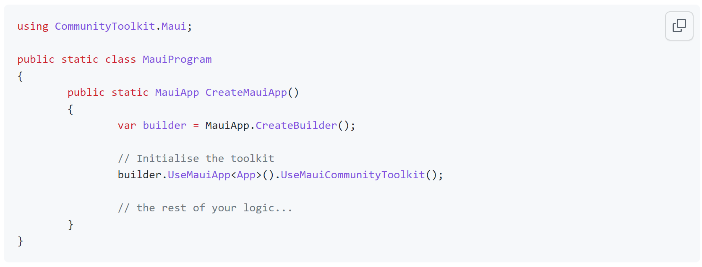
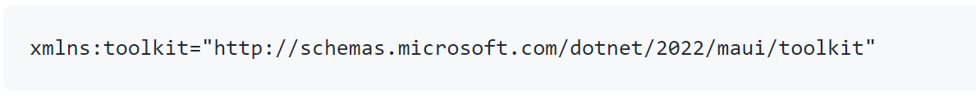
Bonus
https://github.com/CommunityToolkit/Maui

Slide 31
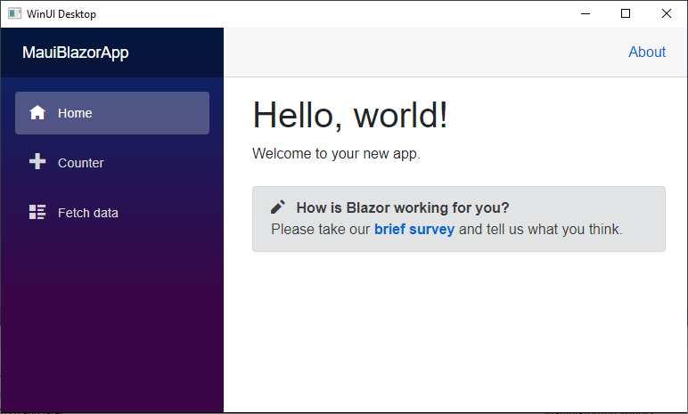
Blazor Hybrid
Bonus
Mix your Blazor app and .NET MAUI to create seamless hybrid experience on desktop and mobile.
BlazorWebView hosts web app
Access any .NET MAUI API from Razor
Combine web UI and native UI
Low memory footprint

Slide 32
Learn More!
How to become an expert.

Slide 33
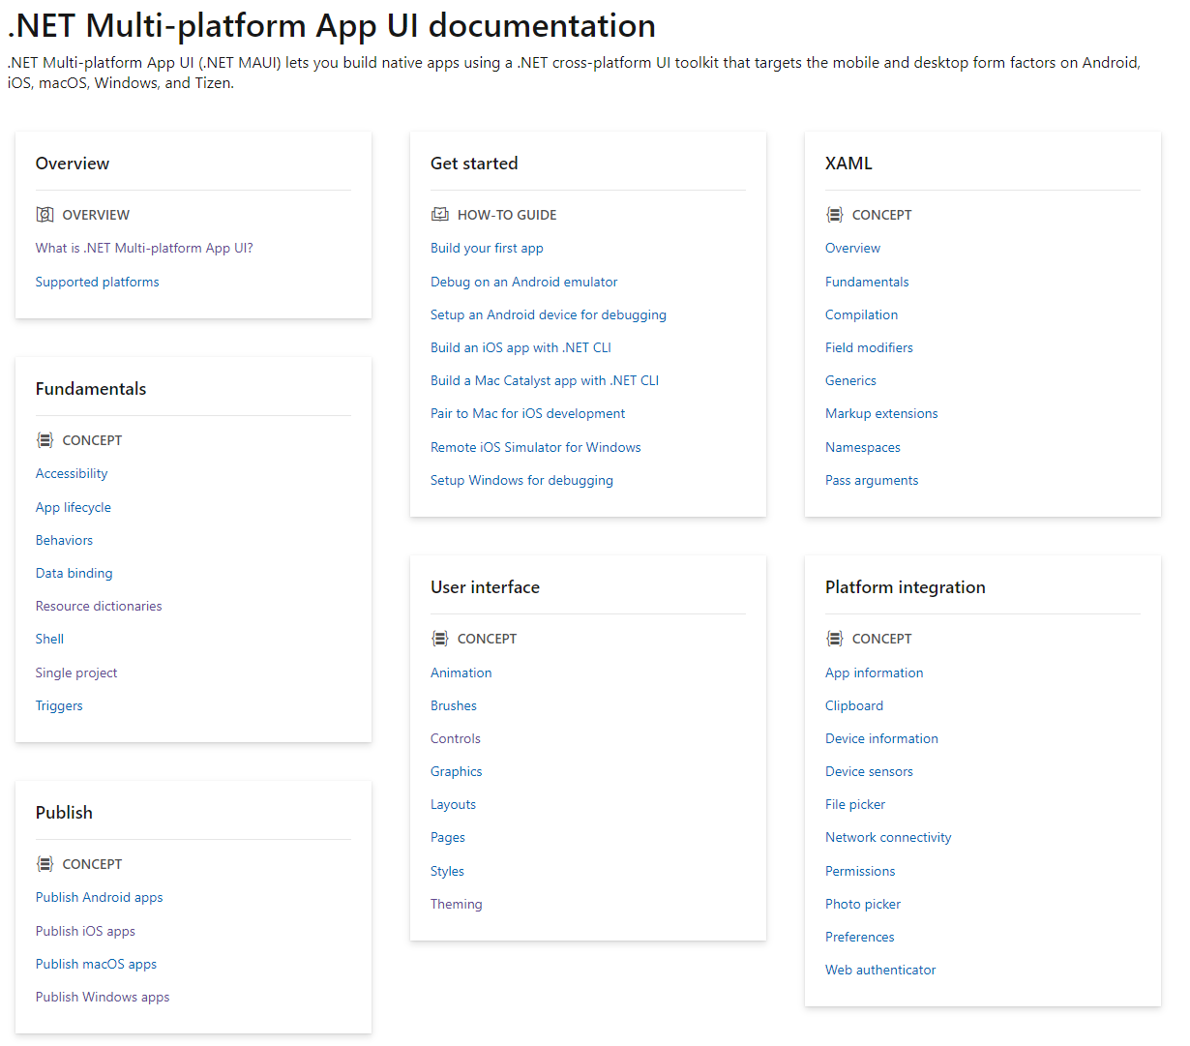
Docs.Microsoft.com
Learn
https://bit.ly/3xeLIkz

Slide 34
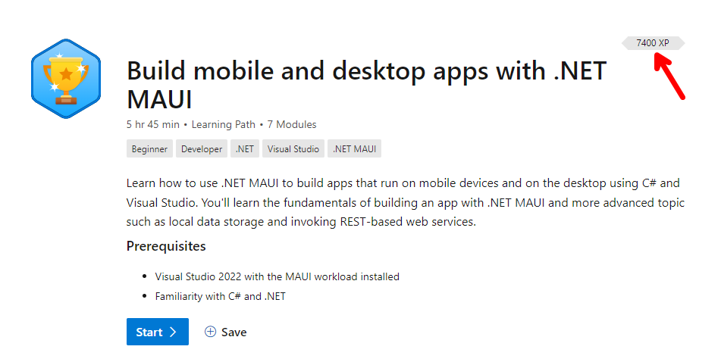
Microsoft Learn
Learn
https://bit.ly/3xoEewI

Slide 35


YouTube
Learn
https://bit.ly/3MvBvG1
https://bit.ly/3tjxg9Z

Slide 36
FAQs
https://github.com/dotnet/maui-samples
https://github.com/jsuarezruiz/dotnet-maui-showcase
Questions, worries, and the hunt for the cheese.
Clifford Agius
Cliffordagius@CA-Software.co.uk
@CliffordAgius
@CliffordAgius@hachyderm.io

Slide 37
Should I use Xamarin.Forms now, or wait for .NET MAUI?
Use it now Xamarin.Forms will end of life 1st May 2023.
Your project will upgrade to .NET MAUI.

Slide 38
Will you migrate my solution to “Single Project”?
No, your existing projects will continue to work without Single Project. We will migrate projects in place to the .NET 7 common project system.
Documentation will be provided if you wish to manually adopt Single Project.

Slide 39
Do I need to rewrite custom renderers?
No. We are making sure the renderer pattern still work.
You may want to migrate them to the lighter handler pattern at your convenience.

Slide 40
Will 3rd party UI libraries continue to work?
Yes! At a minimum they will need to recompile adding a target for .NET 6/7.

Slide 41
Will .NET MAUI run on Linux?
Linux is not a supported platform in this version of .NET MAUI. There is an unofficial backend implemented with GTK.

Slide 42
What “flavor” of XAML will .NET MAUI use?
The same XAML you use in Xamarin.Forms today.

Slide 43
Where can I follow progress?
github.com/dotnet/maui

Slide 44

Thanks for joining !

